Slide 1



Genome-wide Gene-environment Interaction Analysis of Childhood Maltreatment for Major Depressive Disorder
BESETO · 2022
Yaoyao Sun
Institute of Mental Health
Peking University Sixth Hospital

Slide 2
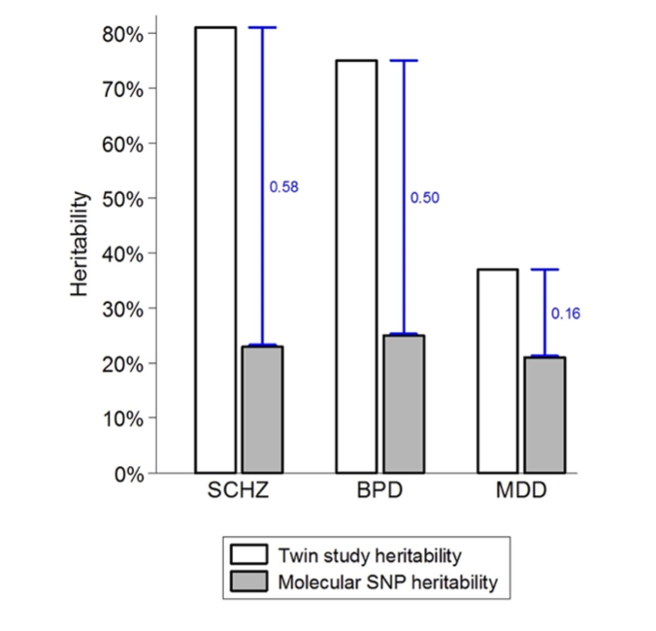
Gene - environment interactions are common in psychiatry
The etiology of most complex diseases involves genetic variants, environmental factors, and gene-environment interaction (G × E) effects
Genetic heritability of MDD: 38%
Environmental factors
in utero exposure to infection
perinatal complications
social disadvantage
urban upbringing
childhood maltreatment
bullying
traumatic events
cannabis use
...
Possible explanations for the heritability gap include G × E, inherited rare genetic variants, and overestimation of heritability in twin studies.
FIGURE 1 | The heritability gap
(P F Sullivan et al., Am J Psychiatry, 2000; Rudolf Uher, Front Psychiatry, 2014; Hanxin Zhan et al., Cell Rep Med, 2022 )

Slide 3
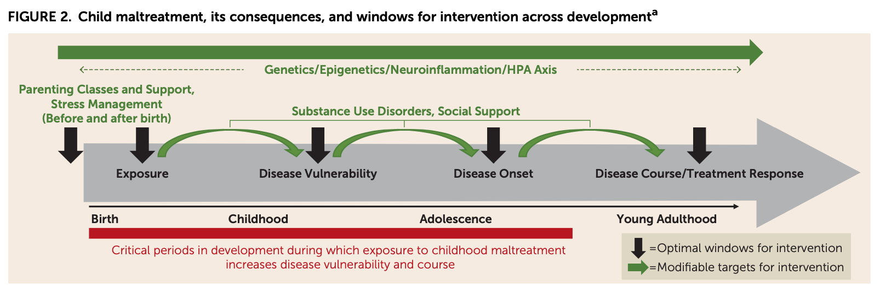
Childhood maltreatment has lasting consequences
Childhood maltreatment: physical abuse, emotional abuse, sex abuse, physical neglect, and emotional neglect
Exposure to childhood maltreatment at any point during development (red bar) can result in long-lasting consequences, including increasing disease vulnerability and illness severity in mood disorders.
(Elizabeth T.C. Lippard & Charles B. Nemeroff, Am J Psychiatry 2020)

Slide 4
Methods
Discovery Sample
(UK Biobank)
Validation Sample
(ABCD)
Genome- wide environment interaction analysis: SPAGE
a SaddlePoint Approximation implementation of G × E analysis
can efficiently analyze large samples while controlling for unbalanced case-control ratios
save time
threshold: 5e-08
threshold: 1e-05
G-by-E validation
Top SNPs
Validation 1:
Incident MDD & Survival analysis
Cross-diagnosis:
Bipolar Disorder
Anxiety
Addiction
Alcohol Use Disorder
Post-traumatic stress disorder
Psychotic experience
Self-harm behaviors
Validation 2:
Adolescents: child behaviors
Validation 3:
Adults: cognition function
Functional annotation and enrichment analysis
(Wenjian Bi, Am J Hum Genet, 2019)
FIGURE 3 | Flow Chart

Slide 5
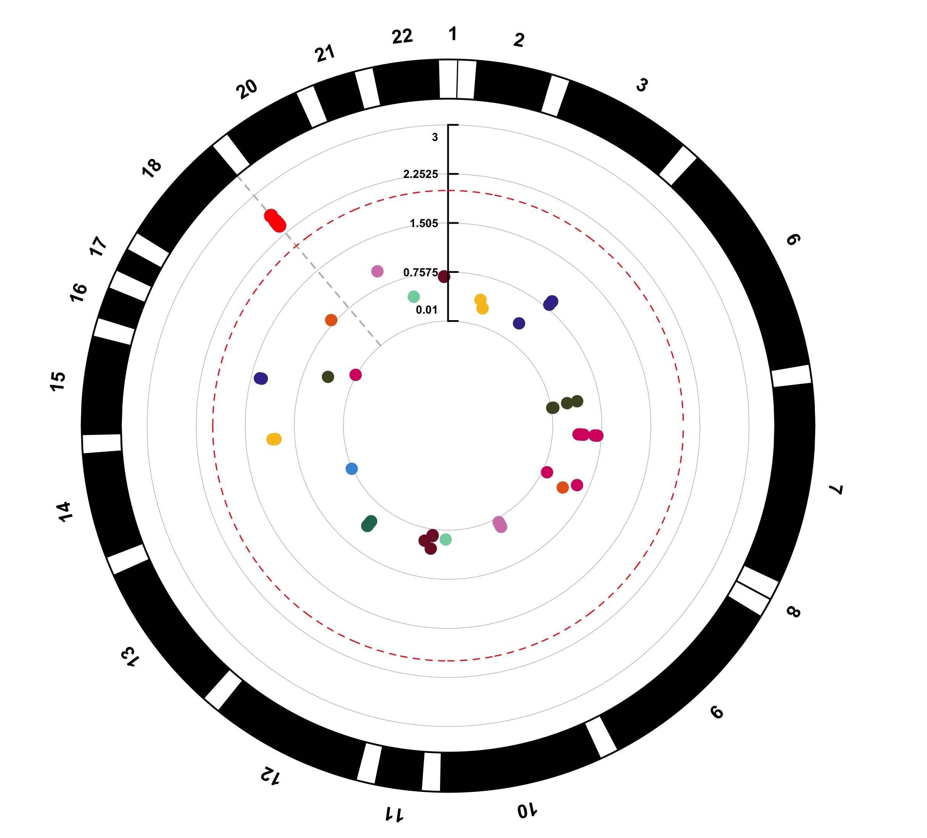
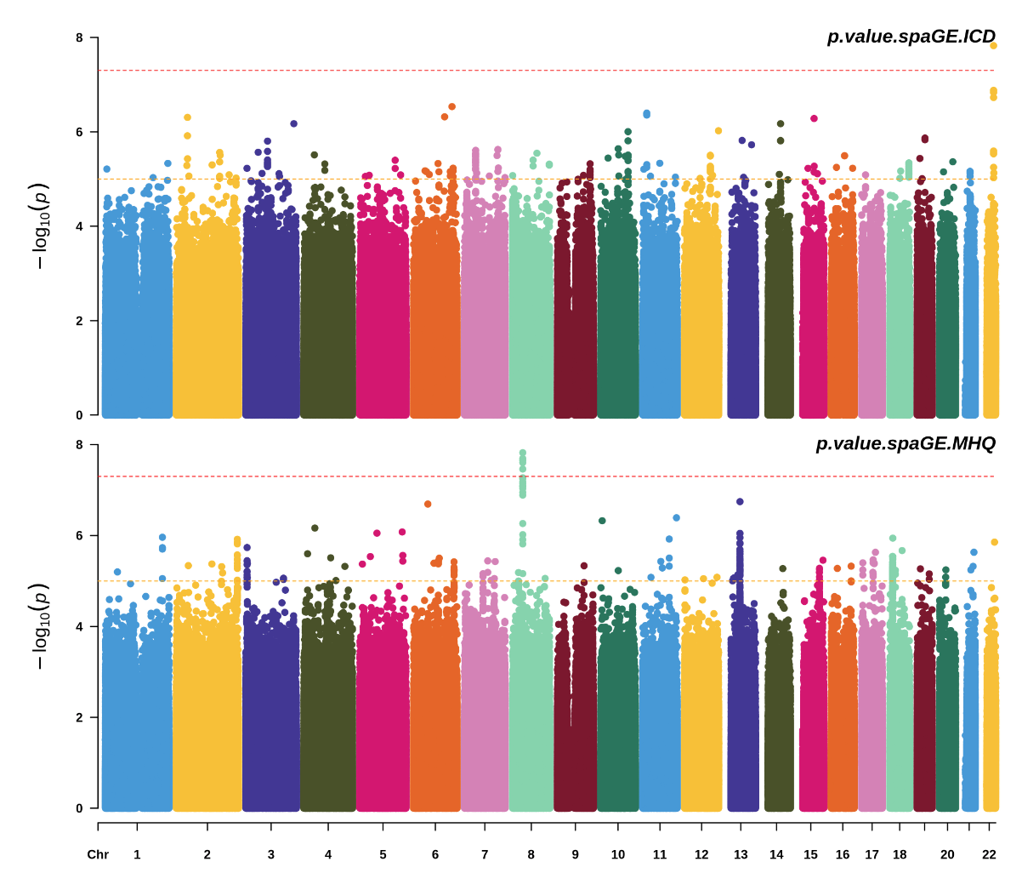
SPAGE analysis identified top risk loci
Sample size
 | MDD definition | Case | Control
Discovery sample | DSM-IV based on mental health questionnaire | 26,664 | 85,716
Validation sample | KSADS youth reported | 220 | 3,557
rs748174876
rs7233072
Discovery sample
Validation sample

Slide 6
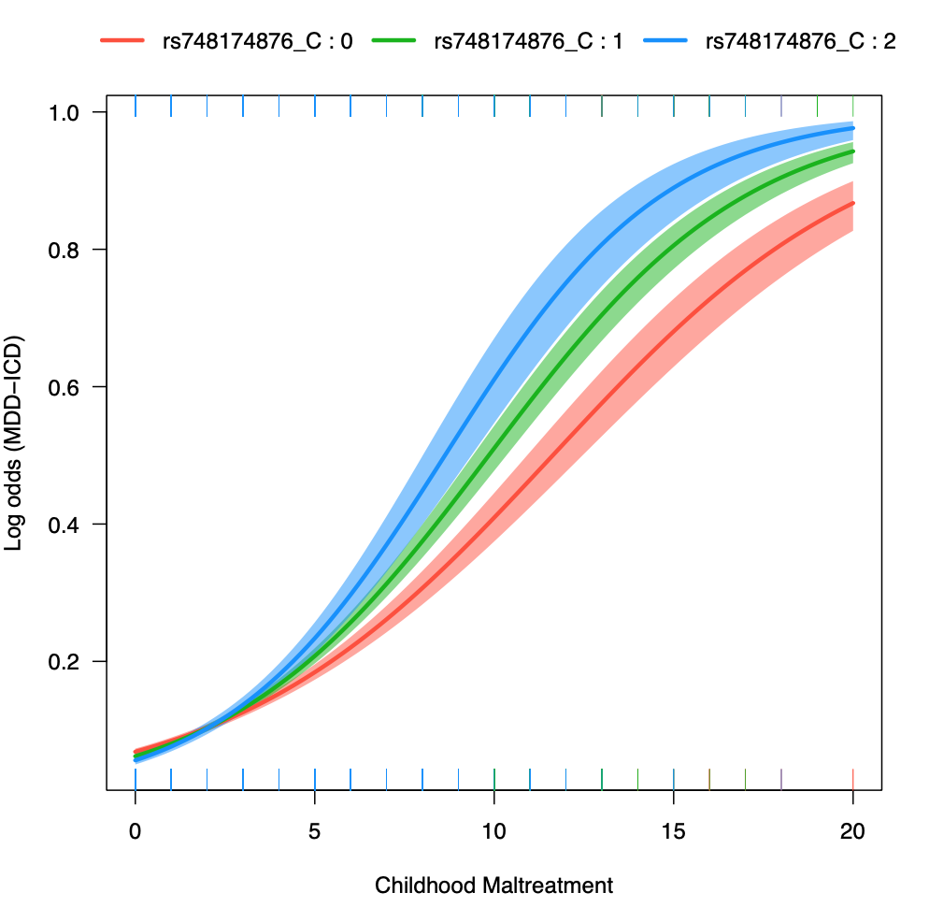
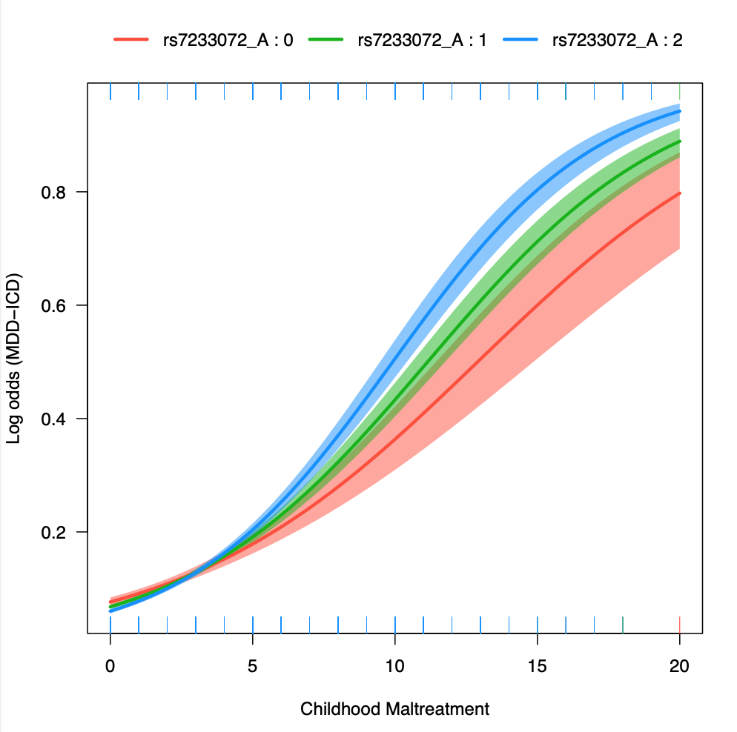
Gene-environment interaction effects
CHR | POS | ID | REF | ALT | MAF | GE p value | mapped gene | dpSNP func anno
22 | 42806664 | rs748174876 | CA | C | 0.30 | 1.49E-08 | NFAM1 | intronic
18 | 74762476 | rs7233072 | A | G | 0.27 | 9.15E-06 | MBP | intronic
rs748174876 | NFAM1
rs7233072 | MBP

Slide 7
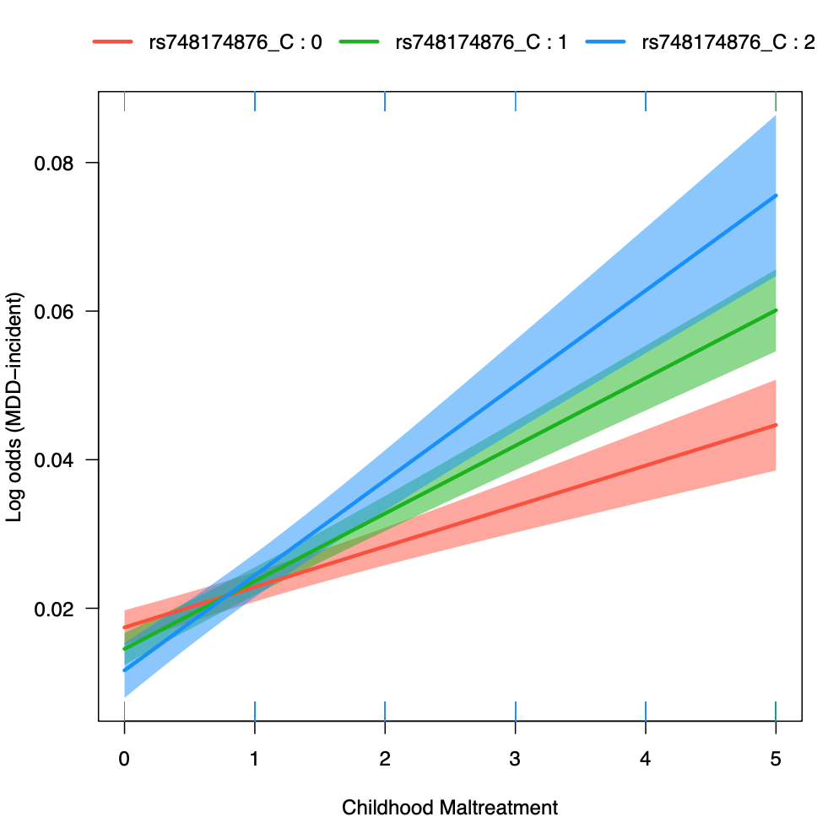
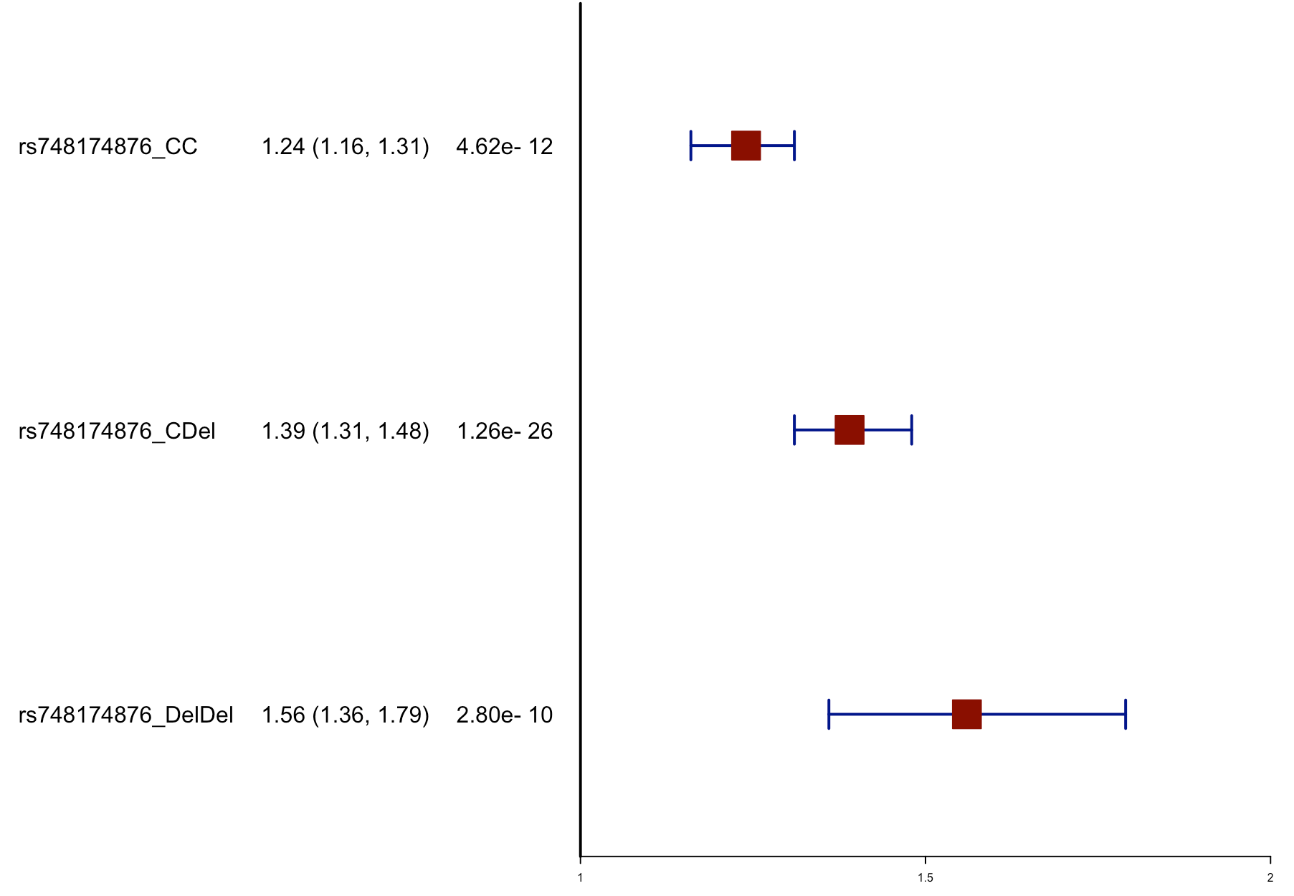
Incident MDD & Survival analysis
Sample size: n(case)=1,862 n(control)=84,886
rs748174876 | NFAM1
HR (95%CI) p value
Incident MDD
Cox regression analysis

Slide 8
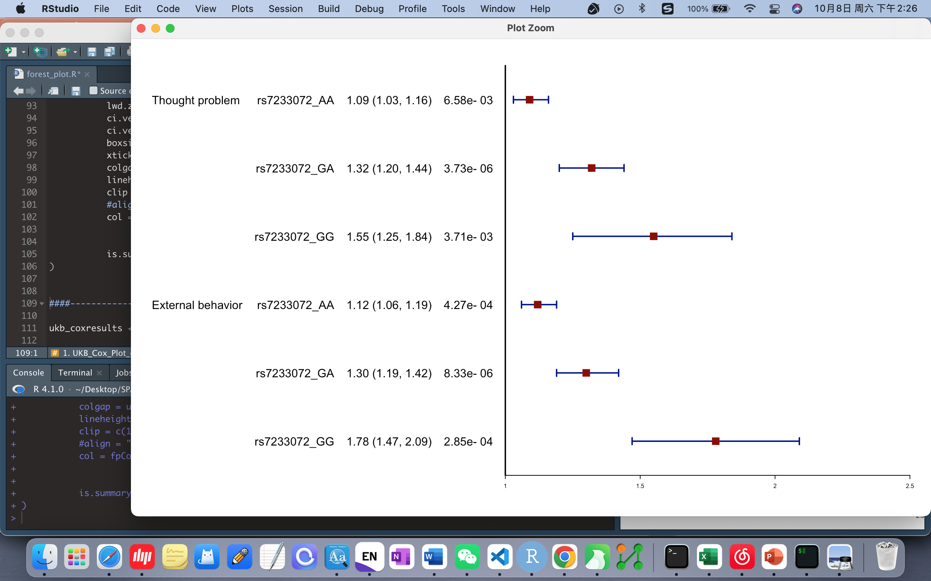
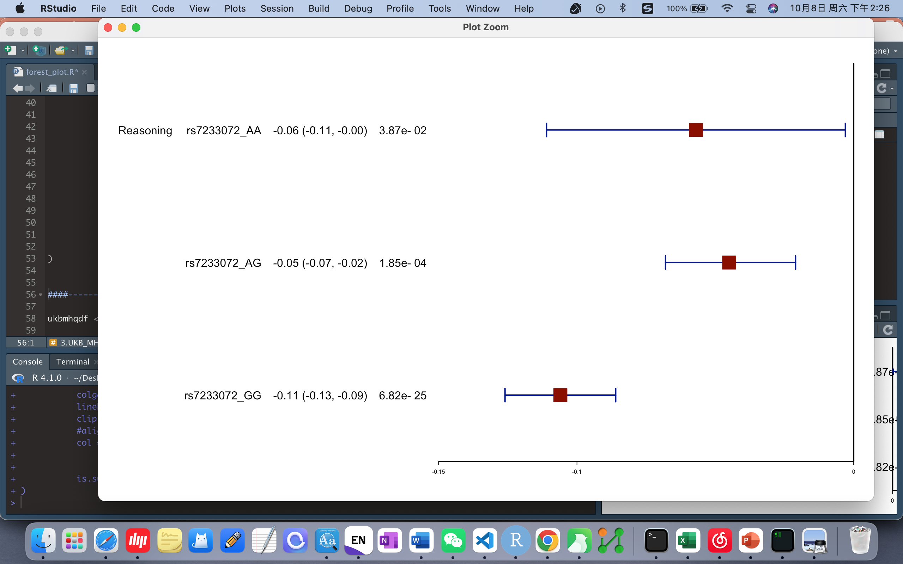
Behavior in adolescence & cognition function in Adult
rs7233072 | MBP
OR (95%CI) p value
Beta (95%CI) p value
Child behavior in adolescence measured by CBCL
Fluid intelligence / reasoning in adult

Slide 9
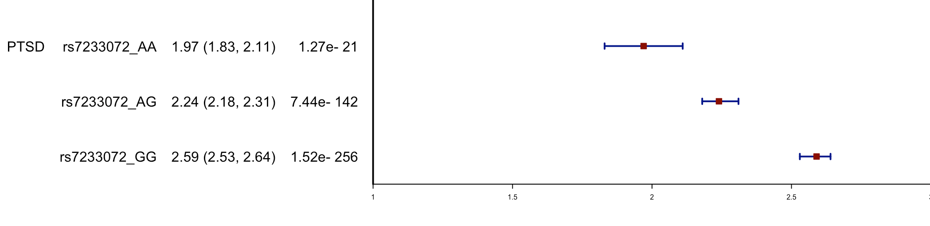
Cross-diagnosis validation
Cross-diagnosis phenotypes
(DSM-IV based on mental health questionnaire)
Bipolar Disorder
Post-traumatic stress disorder
Anxiety
Addiction
Alcohol Use Disorder
Psychotic experience
Self-harm behaviors
Not worth living
rs7233072 | MBP
OR (95%CI) p value

Slide 10
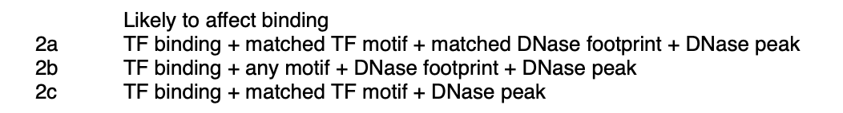
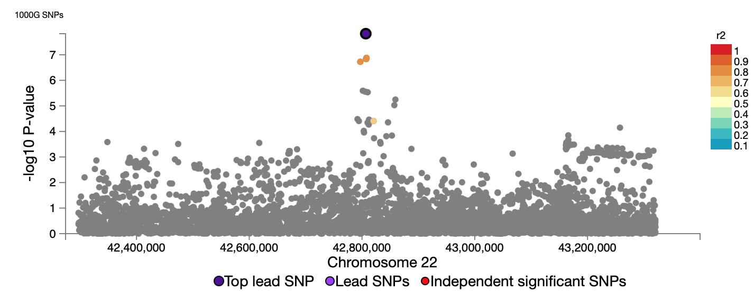
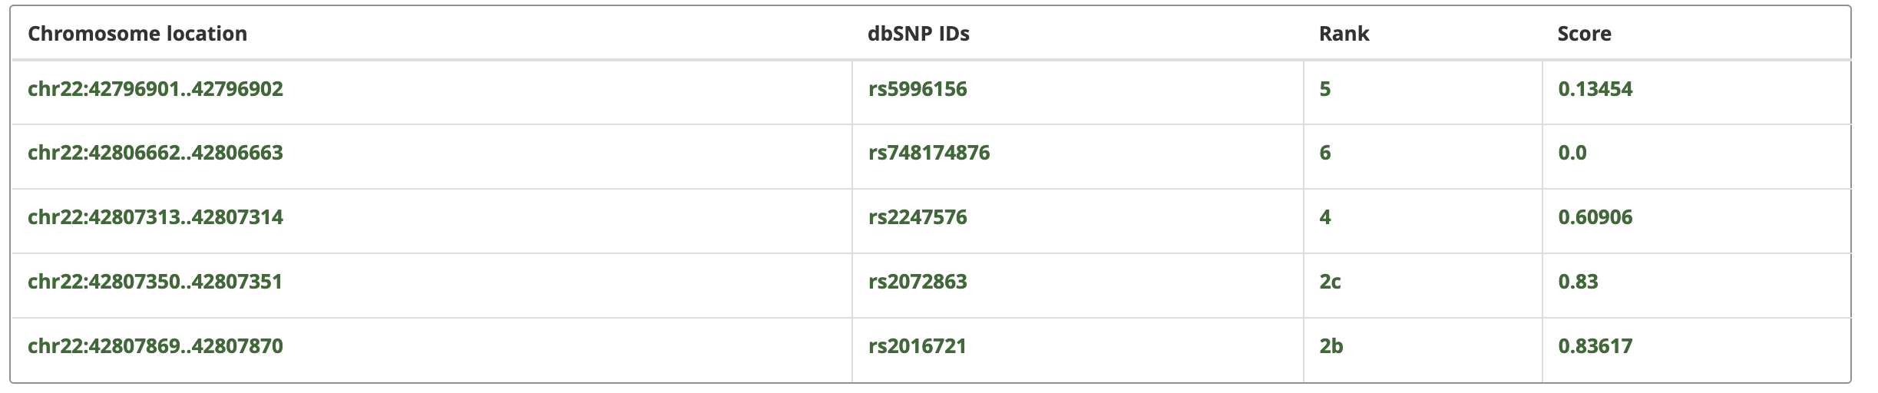
RegulomeDB and HaploReg annotated regulatory information
rs748174876 (22q13.2, NFAM1)
6 candidate SNPs with LD r²>0.6
As predicted by HaploReg, rs5996156, rs2247576, rs2072863 and rs2016721 could change 5, 2, 2 (i.e., NF-kappaB), and 3 DNA motifs for DNA-binding proteins, and could have regulatory effects on gene transcription
The protein encoded by NFAM1 is a type I membrane receptor that activates cytokine gene promoters such as the IL-13 and TNF-alpha promoters

Slide 11
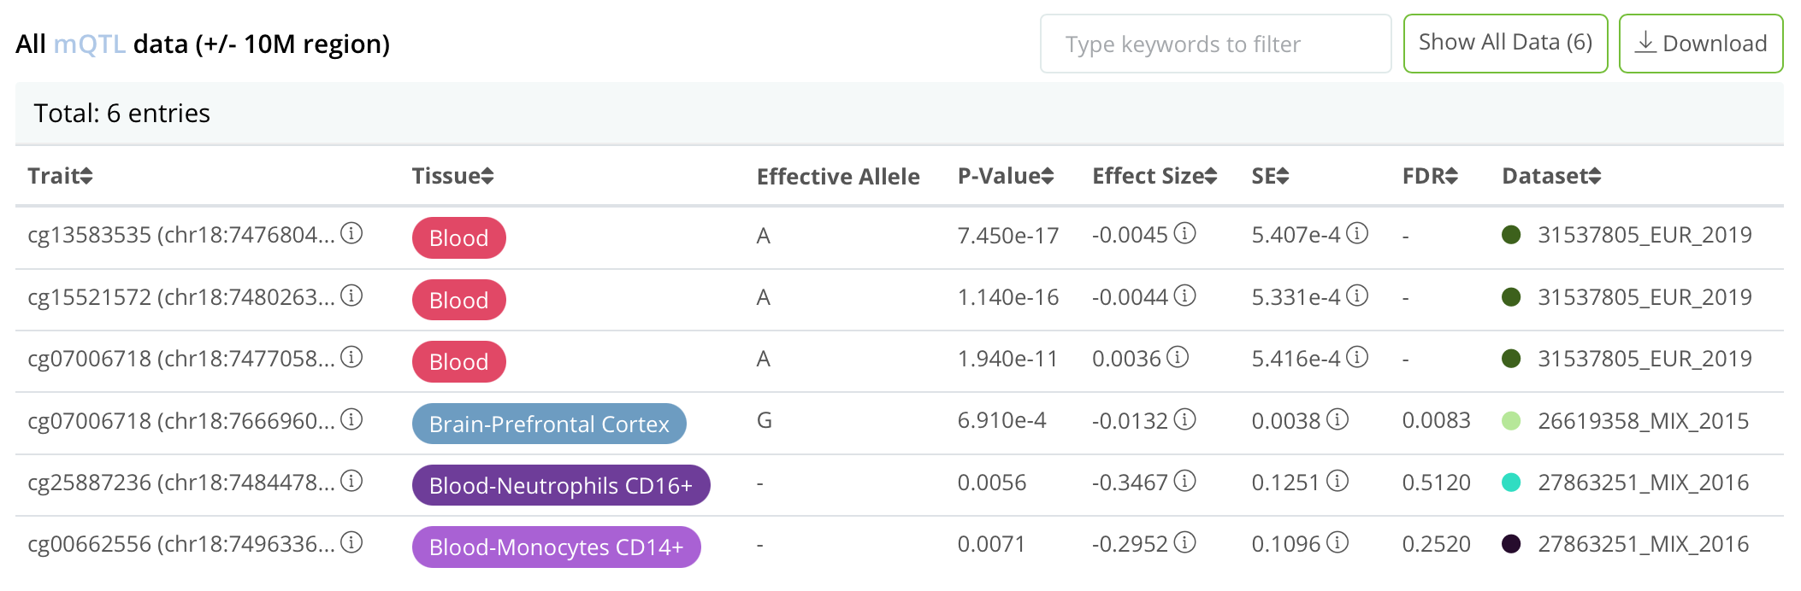
QTLbase annotated mQTL effect
rs7233072 (MBP)
Human Brain Transcriptome
rs7233072 showed significant mQTL effect on cg07006718 located in MBP gene (P-fdr = 0.0083)
As predicted by HaploReg, the LD loci rs7227084, rs8088143, rs8084674, rs7232525, rs12959308, rs12959886 and rs7232346 could change 16, 10, 4, 4, 1,2 and 8 DNA motifs for DNA-binding proteins
The protein encoded by the classic MBP gene is a major constituent of the myelin sheath of oligodendrocytes and Schwann cells in the nervous system

Slide 12
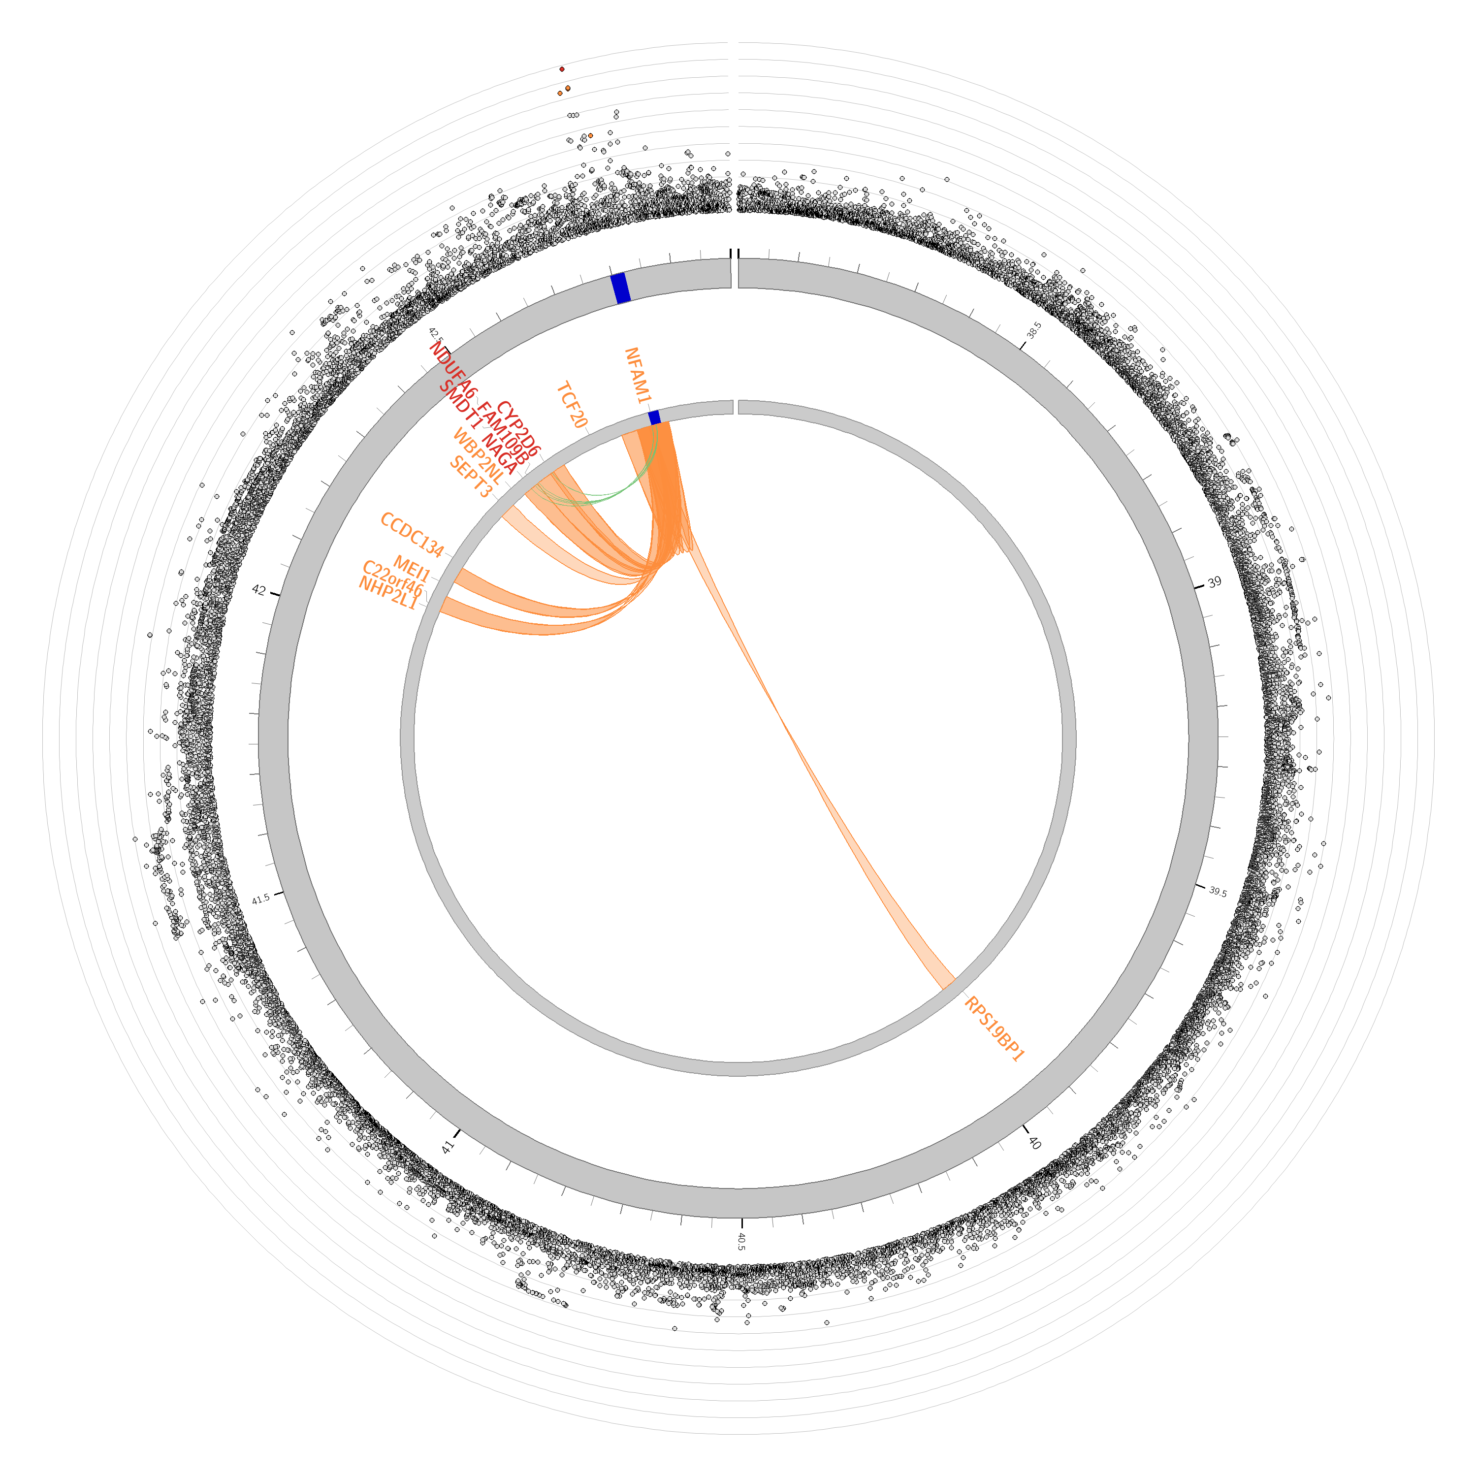
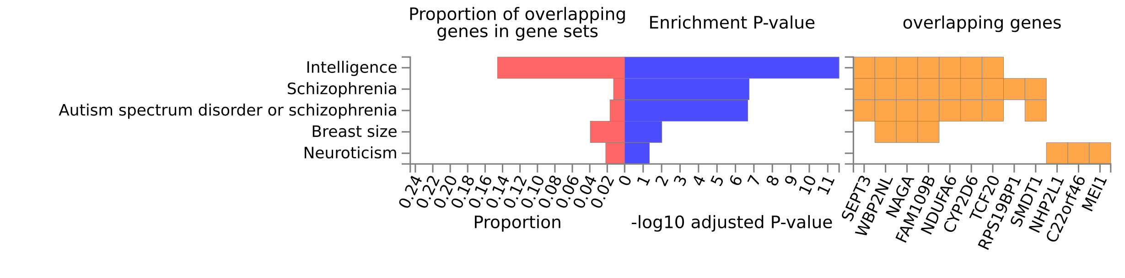
Functional gene mapping
13 mapped genes by chromatin interactions or eQTLs
eQTL: NAGA, FAM109B, SMDT1, NDUFA6, CYP2D6,
chromatin interactions: TCF20, RPS19BP1, NHP2L1, C22orf46, MEI1, CCDC134, 3-Sep, WBP2NL
GO enrichment analysis

Slide 13
Conclusion
Individuals with rs748174876 deletion variant and rs7233072 GG genotype were much more susceptible to major depressive disorder once they experienced childhood maltreatment
The current study support the possible immune mechanisms in the pathogenesis of depression
Animal experiments are needed in the future

Slide 14
Thanks!
Yaoyao Sun
sunyaoyao@bjmu.edu.cn

